Slide 1
CS 4360: CubeSat Presentation
Justin Figueredo
Lucas Nieddu
Logan St. Cyr

Slide 2

Purpose and Goals for Sprint 03
Purpose: Meet the necessary requirements for a 31 October launch with the MSU Denver Aerospace department. Ensure that the data is readily accessible and readable.
Goals: Confirm communication between ground system and transmission unit, and check that there is no conflict between our data transmission with the APRS used by MSU AES. In addition to the communication aspect, our team set out to house the necessary data in another Raspberry Pi for easy access and viewing. Continue seeking out funding and funding and stretch goals.

Slide 3
Management:
As we move towards the next sprint of implementing sensors and collecting sensor data the management side has moved to researching which sensors will be satisfactory for our eventual near orbit launch
Pressure, temperature, radiation, and contamination all become mitigating factors when attempting to put an object into orbit
The transition from off the shelf components to more specific and robust components require that the team seek higher levels of funding through the AIAA and other potential partnerships through satellite companies large and small
AIAA has stated the CubeSat team can begin recruiting from their student pool of aerospace experts, professional contacts, and graduate students
MSU Denver office of Student Activities may be able to provide some level of funding although it may be limited
Balloonsat Mission paperwork will be filled out to accommodate sensors once we can certify the reliability of sensors

Slide 4
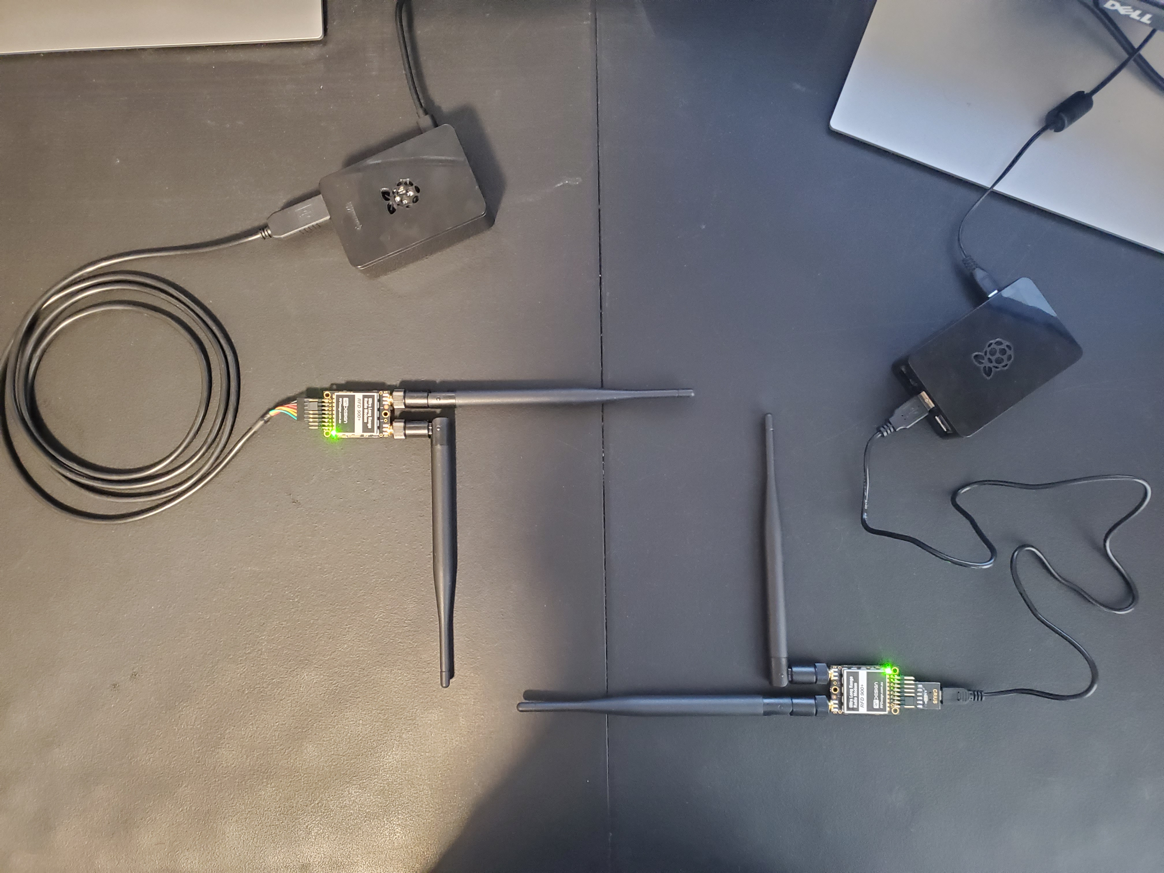
Connecting the RFD900x Modems
Had to ensure that the signal between the RFD900x would not conflict with the planned signal from the Amateur Radio Club for their Automatic Packet Retrieval System (ARPS)
Verified the system was able to send packetized data between transmitter and ground station
Range has yet to be tested, but with the balloon flight only going to 100,000 ft the communicator is well within the acceptable range

Slide 5
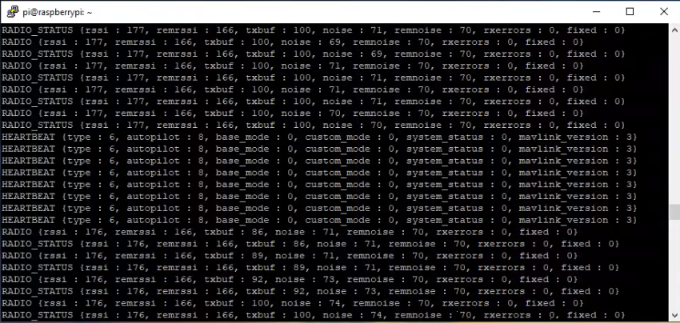
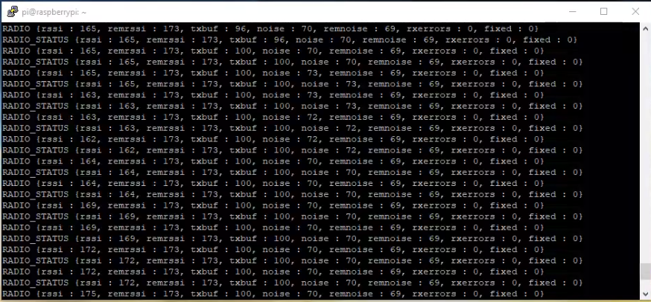
Ensuring the Packet of Data was Transmitted
Two python scripts running on the raspberry pi
One waits for a message and the other sends a signal
Once a signal is received the two units begin transmitting and receiving data

Slide 6
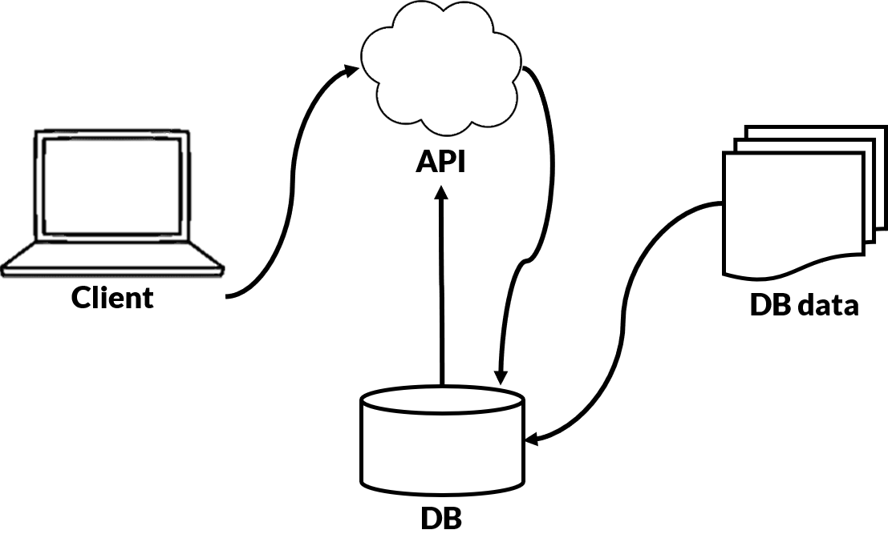
Data Storage using restful APi
Simply put, a RESTful API (REST API) allows two computer systems to talk to each other over HTTP.
This is done in a similar way to web browsers and servers
We are using an existing MongoDB client python-rest-db-client
When we get sensor data, we will add that data to this RESTful database.

Slide 7
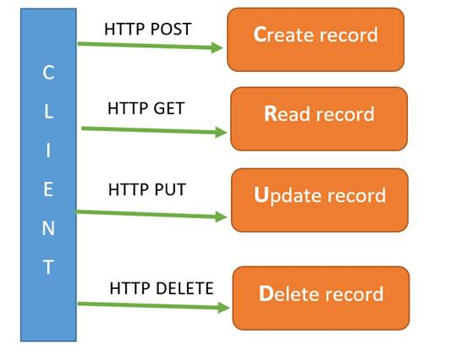
Data Storage using restful Api (cont)
Simple solution to data storage (sensor data)
There are python3 libraries available connected to RESTful API
Allows us to perform basic CRUD (Create, Read, Update, Delete) operations
Connect to our database from any system

Slide 8
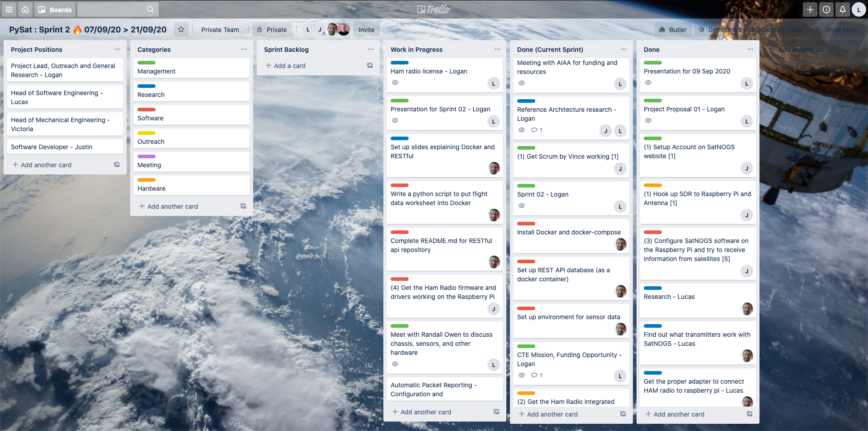
Trello Board

Slide 9
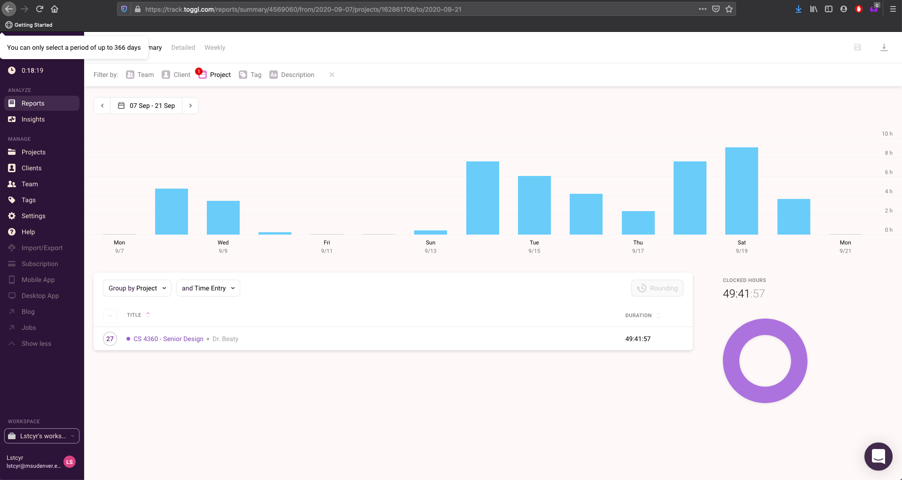
Toggl Time

Slide 10
Look back
Our team discussed roles and comfort level in the roles
Current roles will remain the same, switching over hardware and software responsibilities depending on interest
Met and exceeded all deliverables for each sprint before the final due date

